Slide 1
MINOR PROJECT GUNSHOT DETECTION
Sahil Jangra (CO16348)
Saksham Gupta (CO16349)
Vivsvaan Sharma (CO16362)

Slide 2
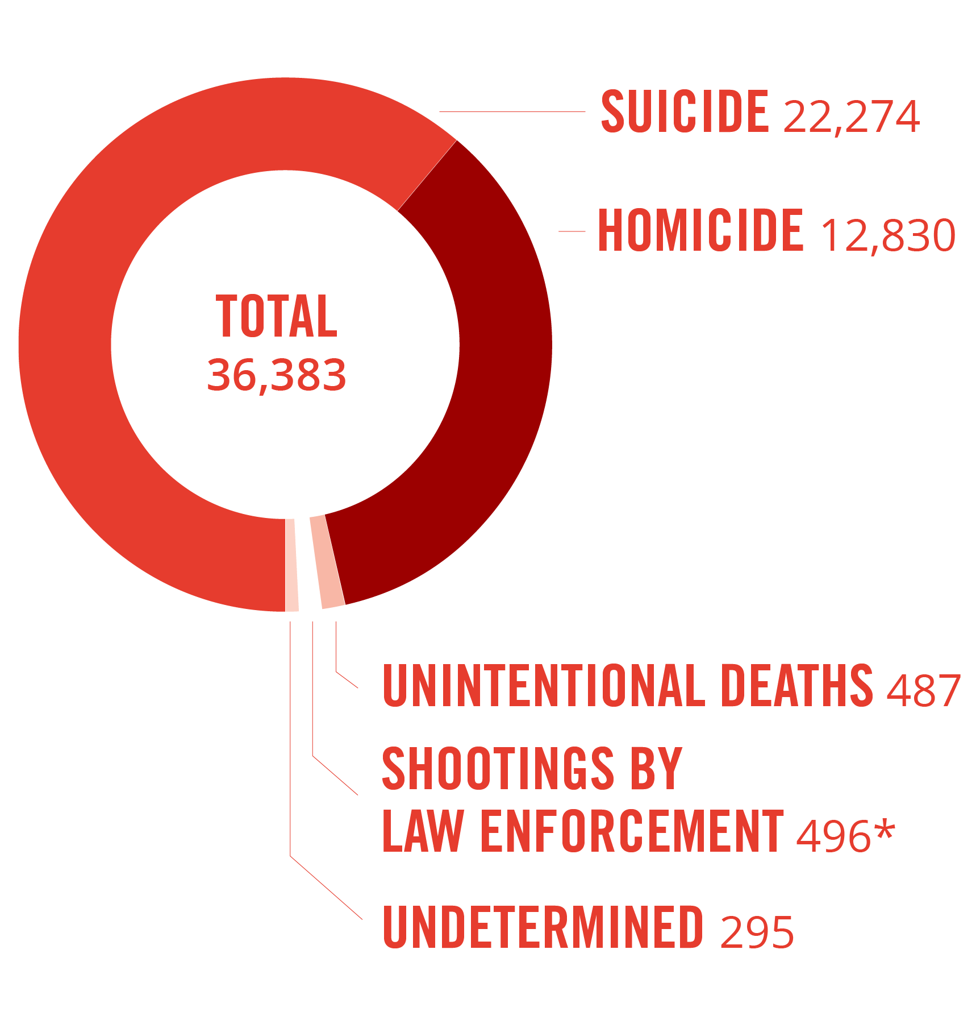
STATISTICS
A just released study has found that India has the distinction of having the third highest number of gun-related deaths out of 195 countries surveyed.
The absolute number of firearm deaths were 22,500 in 1990, which went up to 26,500 in 2016.
Studies 251,000 people died globally from firearm injuries in 2016, compared with 209,000 deaths in 1990".

Slide 3
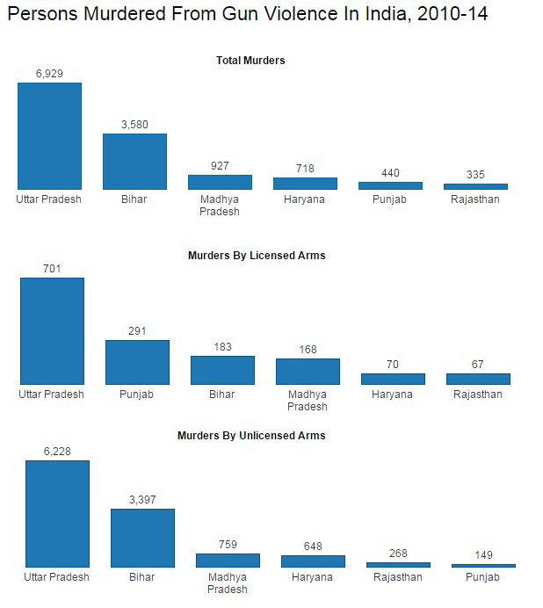
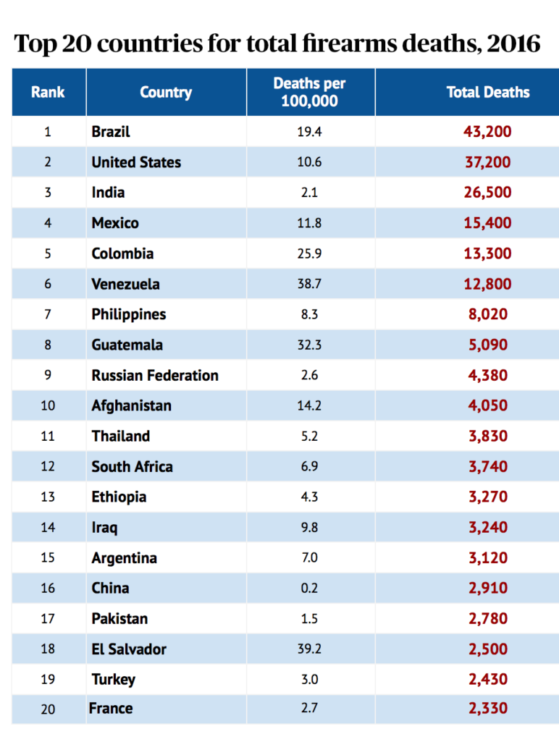

Slide 4
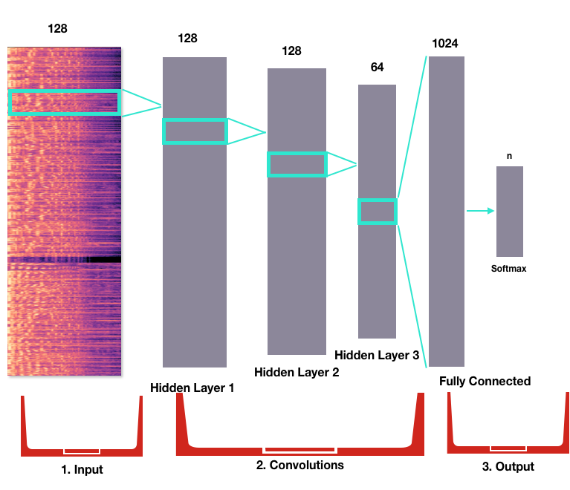
PROJECT DESCRIPTION
This project is designed to be an addition to the currently available home and vehicle security systems specifically focused to reduce and prevent armed violence and provide immediate notification and support to the owners and the concerned legal authorities.
The current status Quo indicates that there has been an increase in the crimes involving guns over the past few years. With domestically produced guns available through backdoor sellers, it becomes important to ensure preventive measures against such scenarios.

Slide 5
Our project is a deep-learning based sound detection and classification system focused on detecting and isolating sounds of gunshot and gunfire from the other ambient environmental sounds.
The sound model would consist of an image classifier which would take a sound sample spectrogram as an input and classify it among ambient and dangerous (gunfire) sounds.
For any positive identification of a gunfire, the current location of the recording device would be sent to the pre-registered contacts and to the nearest police stations.
This would ensure that fast and efficient action can be taken against such crimes which, at present, go unnoticed for most cases.
As soon as a single gunshot is detected, the real time location can be shared, to provide medical aid, and to ensure no further armed conflict takes place.

Slide 6
PREVIOUS WORK
The performance of Sound Classification like ESC-50 Classification, Environmental Sound Classification, etc. has been significantly improved with the evolution of Deep Neural Networks (DNN).
Models which use Convolutional Neural Networks (CNN) for classification of sound based on the spectrograms obtained for different sound samples have been proposed regarding the given images.
These along with the other model can be used for separation of various image spectrograms
Any particular work in regards to Gunshot detection using image spectrograms has not yet been published specifically with as high an accuracy.

Slide 7

PRACTICAL ASPECT
The model could be packaged as an API to be used alongside other mobile applications, as a standalone application, a web-based application, of using a low-cost hardware recorder and a microchip to be used in vehicles.
For software-based solutions, the built-in device recorders can be utilized, along with periodic sound detection and classification, using a low usage sound-spectrogram script and pre-trained model.
The current accuracy of the model, with over 4000 ambient sounds stans at 99.74%, which can be seen as viable practical results.

Slide 8



TECHNOLOGY STACK
PYTHON – Python 3.x would be used as the primary coding language where multiple python functionalities like class operations, functions, dictionaries and other features will be utilized for building the project.
FASTAI - The fastai library is a PyTorch wrapper library which enables training fast and accurate neural nets using modern best practices. We will build our classification model using this library.
LIBROSA - LibROSA is a python package for music and audio analysis. It provides the building blocks necessary to create music information retrieval systems.

Slide 9
IDEA NOVELTY
Rather than directly generating spectrograms from the audio samples, we have normalized the audio by removing noise in the extremely high or low frequency ranges.
This was done using hi-pass and low-pass audio filters to generate smooth and in-range audio for better conversion and to highlight irregularities in the middle frequencies.
The normalized audio was then divided into sub-audio segments for various use cases like burst firing sounds, single shot sounds, and continuous firing sounds, each with an interval of 2s, 5s, and 10s respectively.
The spectrograms thus generated were highly specific for their own audio sub groups.
Combining these specific spectrograms during network training enables us to create a generalized network while still retaining the original accuracy.

Slide 10
PROJECT BLUEPRINT
The project is divided into stages which will be followed in incremental order throughout the project duration. Since this project involves some hardware integration, an early hardware-based prototype has to be considered as future work.
At the initial stages of the project, we will collect data of various gunshot sounds from multiple sources. These sounds will include single round shots, multiple firing sounds, reloading sounds and burst fire sounds.
Since no such dataset is available, we will build our dataset using manual data collection from web scraping, audio extraction from relevant videos, gun sound imitations and direct audio downloads.

Slide 11
These audio files would then be cleaned from background or white noise, converted into single channel time restricted audio samples, separated in time intervals and normalized from peak-to-peak for the purpose of spectrogram generation.
Since the project would be used alongside ambient environmental sounds, it is also important to collect audio samples of ambient noises and to differentiate between the gun sounds and the latent environmental sounds.
The sound spectrograms would then be generated on the fly using LibROSA which will be fed to the classifier for class outputs.
These spectrograms are generated on a bit by bit basis and utilize multiple audio samplings to create accurate and sample specific images.

Slide 12
The generated images will be used by the classifier model built using fastai and Residual Networks to classify between Gunshot and Non-Gunshot sounds and to distinguish between ambient noise and outliers.
After attaining a decent accuracy, we can then use the classifier for the test cases by using, as inputs, real time sounds at defined periods to detect armed crimes and gunshots.
This built prediction model can be used as a modular backend for safety application or paired with recording devices and a GPS tag for use in homes and vehicles.
During a time of positive detection, the location of scene can be sent to trusted authorities automatically without delay.

Slide 13
USE CASES
As an API - We can run the independent prediction model on a server where different mobile and web application can send requests with their image spectrogram and the model will return results in a convenient JSON or XML format indicating the predicted result.
As a module – For faster processing a precompiled and stored model can be used as an add-on module for mobile application, computer systems or smart devices for direct prediction and result analysis.
Paired with hardware – As stated before, the primary task for this project is to ensure a reduction in violent crimes involving guns. Hence paired with appropriated audio recording hardware, we can install a low-cost safety system in vehicles which detect these sounds on the streets and roads, where a majority of these crimes take place.

Slide 14
DATASETS
GUNSHOT: The gunshot spectrograms were created from various gun classes which have been used in the dataset like ak-47, m4a4 etc.
The dataset was collected from various sources and was cleaned, compiled and normalized by us. The gunshot sounds were primarily available of various FPS gaming systems, whose audio files we extracted.
Apart from them, online open source audio samples were taken from multiple sites and then checked for quality and consistency with the current dataset.
If the new audio files were considered feasible, they were normalized, split into convenient sub-audio sets and converted into spectrograms using librosa.

Slide 15
ENVIRONMENTS SOUNDS (ESC-50): The ESC-50 dataset is a labelled collection of 2000 environmental audio recordings suitable for benchmarking methods of environmental sound classification.
The dataset consists of 5-second-long recordings organized into 50 semantical classes (with 40 examples per class) loosely arranged into 5 major categories
Clips in this dataset have been manually extracted from public field recordings gathered by the Freesound.org project. The dataset has been prearranged into 5 folds for comparable cross-validation, making sure that fragments from the same original source file are contained in a single fold.

Slide 16
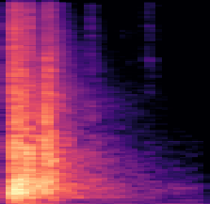
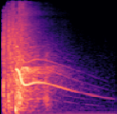
SAMPLE INPUTS
Gunshot Sounds as Input

Slide 17
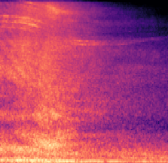
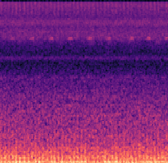


Environmental Sounds as Input
Colour Highlighting

Slide 18
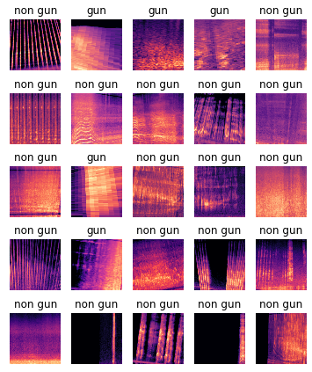

Slide 19
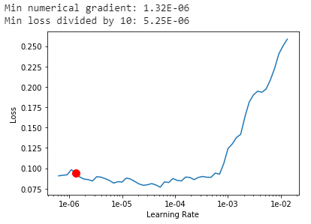
OUTPUTS AND DISCUSSION
LEARNING RATE GRAPH

Slide 20
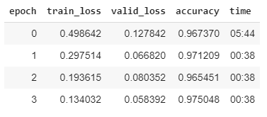

EPOCH VARIANCE
Beginning Stages

Slide 21
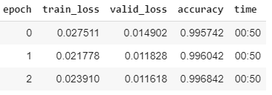

End Stage Variance
Maximum Accuracy

Slide 22
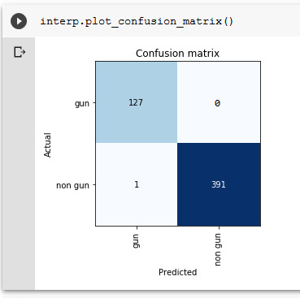
CONFUSION MATRIX

Slide 23
FUTURE WORK
We plan on including other audio phrase detection which is commonly used during a crime scene like ‘Help’, ‘Catch’, ‘Gun’, and ‘Ambulance’ etc., to further spread the scope of the project beyond the current capabilities and to increase the model accuracy even higher and test under practical situations.

Slide 24
THANK YOU

